Slide 1

Welcome!
PRESS THE SPACEBAR TO CONITUE

Slide 2

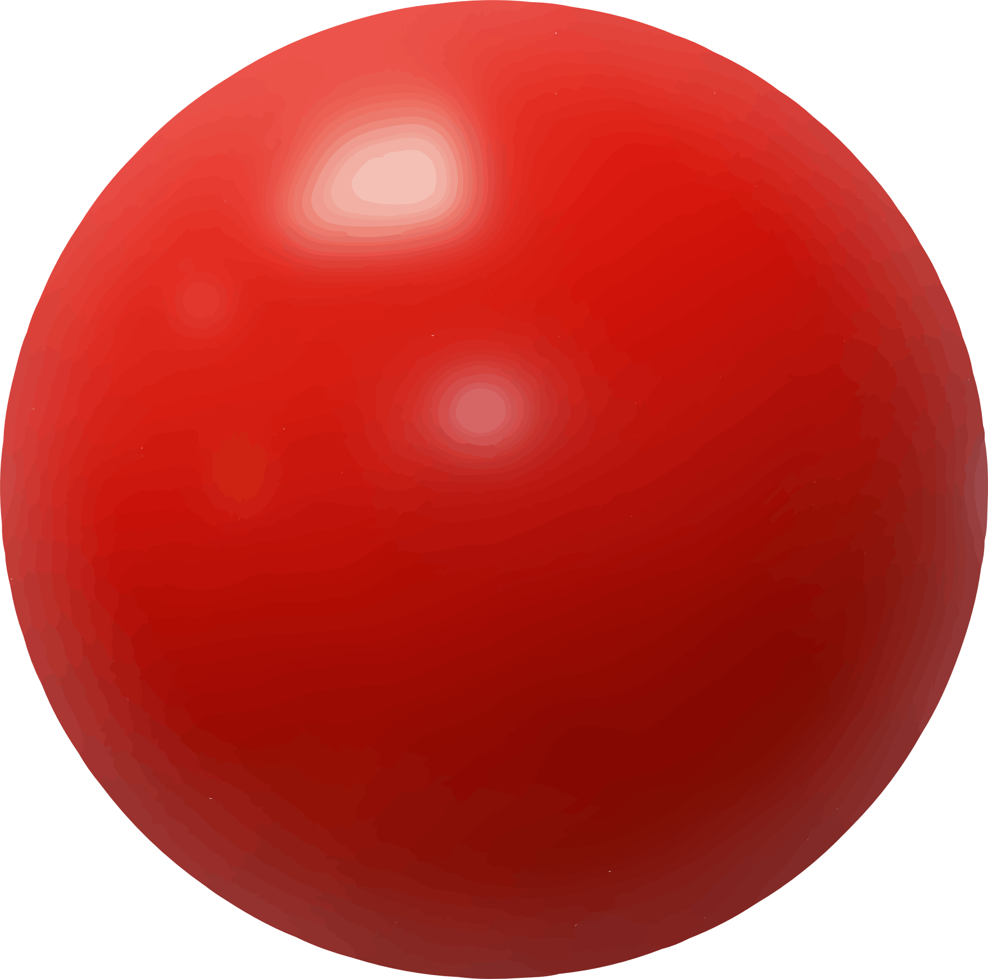
Collect

Slide 3
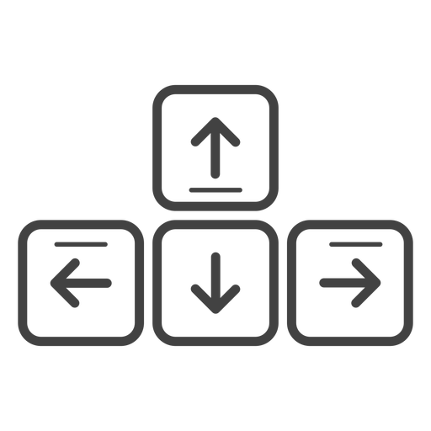
MOVEMENT CONTROLS
To navigate the environment, use the Up-Arrow to move forward, the Down-Arrow to move backwards and the Left-Arrow and Right-Arrow to rotate.
Move Forward
Rotate
Left
Rotate
Right
Move Backward
PRESS THE SPACEBAR TO CONITUE

Slide 5
You’ve Completed the Experiment! Note: The End Experiment button will not end the experiment if you’re running it in the Unity Editor. Press the button at the top of the editor to end the experiment.

Slide 6
You did not successfully complete 3 Trials! Note: The End Experiment button will not end the experiment if you’re running it in the Unity Editor. Press the button at the top of the editor to end the experiment.

Slide 7
You MUST successfully complete 3 of the next 5 trials to continue!

